Slide 1

The Benefits of Social Networking on Literacy
By: Klaudio Xhindoli, Kristopher Boyle, Jamel Thompson, Jose Rivera, David Werling, and Melvin Cairns

Slide 2
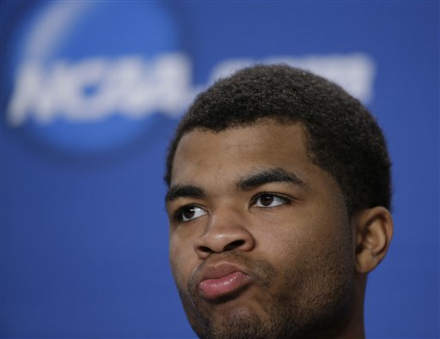
Ponder This…
Notes:
Authority/Credibility:
Current/Continuity:
Content/Bias:
Citations/Links:
Navigation/Copyright:

Slide 3




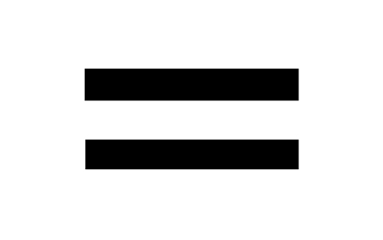
Fantastic!!!
Notes:
Authority/Credibility:
Current/Continuity:
Content/Bias:
Citations/Links:
Navigation/Copyright:

Slide 4
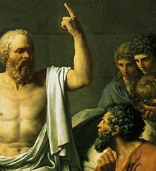
“Just as Socrates was concerned that the invention of writing would make people forgetful, people today are worried about the degree to which we are permanently shaped by digital technologies.” -Paulien Dresscher
Notes:
Authority/Credibility:
Current/Continuity:
Content/Bias:
Citations/Links:
Navigation/Copyright:

Slide 5

A New Blog Every Half-Second
Notes:
Authority/Credibility:
Current/Continuity:
Content/Bias:
Citations/Links:
Navigation/Copyright:

Slide 6
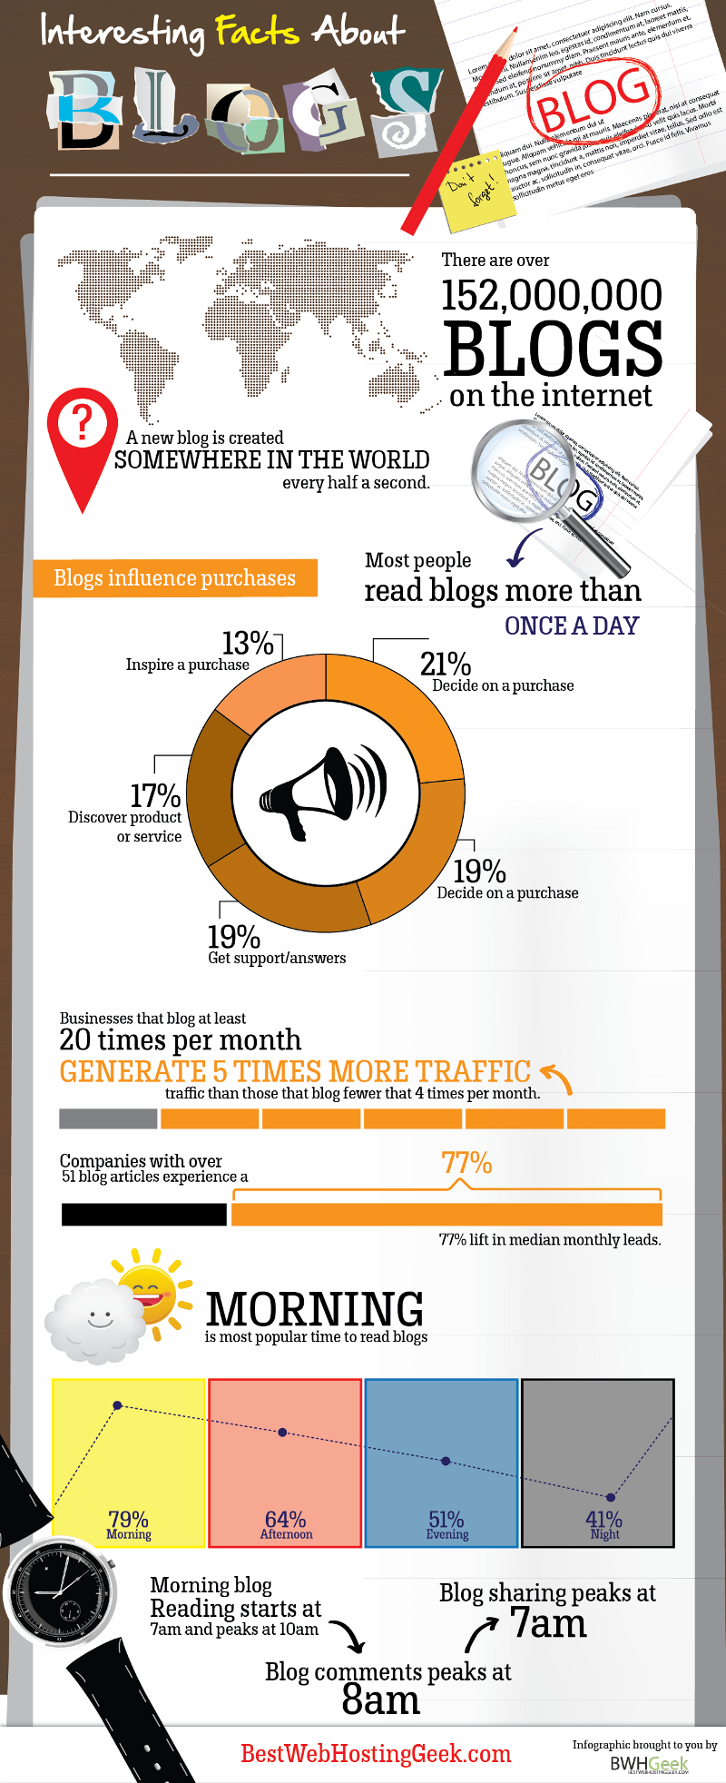
Notes:
Authority/Credibility:
Current/Continuity:
Content/Bias:
Citations/Links:
Navigation/Copyright:

Slide 7
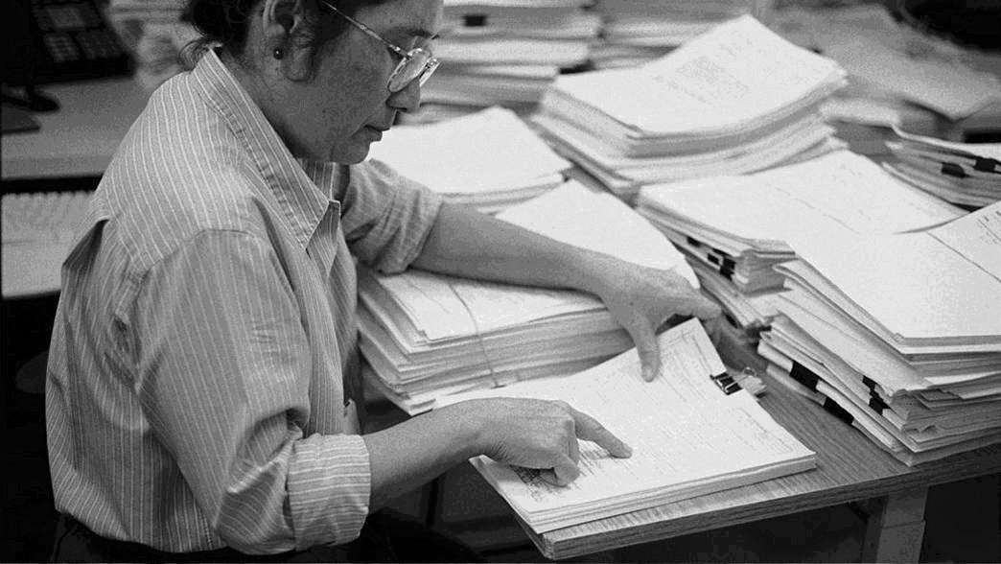
The Ultimate Proofreading
Notes:
Authority/Credibility:
Current/Continuity:
Content/Bias:
Citations/Links:
Navigation/Copyright:

Slide 8
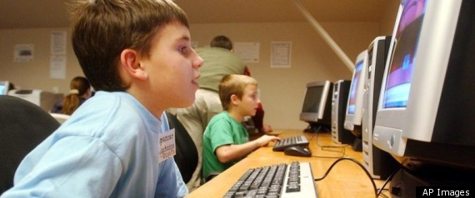
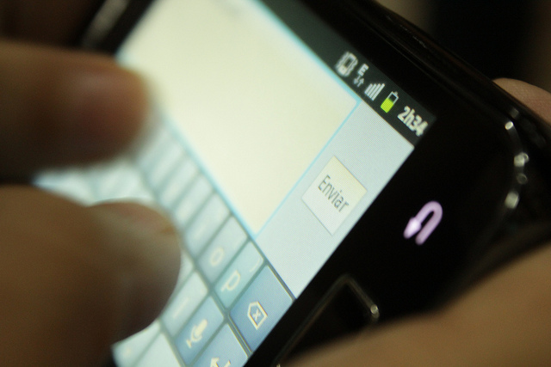
"We have such a huge number of [people who] don't read at all”-Jacquelyn Rhoads
Notes:
Authority/Credibility:
Current/Continuity:
Content/Bias:
Citations/Links:
Navigation/Copyright:

Slide 9
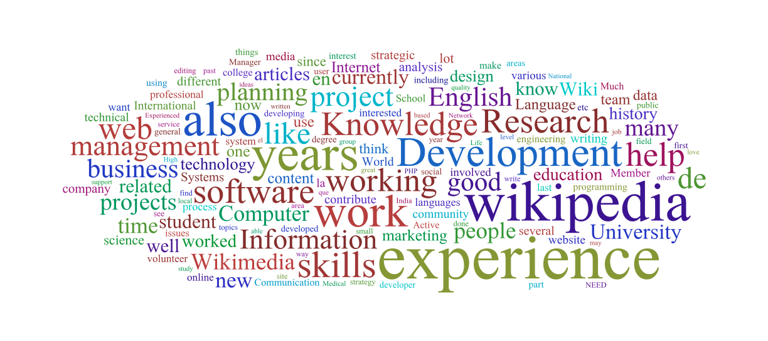
Notes:
Authority/Credibility:
Current/Continuity:
Content/Bias:
Citations/Links:
Navigation/Copyright:
Luminosity reference is not cited.
How does it prove?

Slide 10


Notes:
Authority/Credibility:
Current/Continuity:
Content/Bias:
Citations/Links:
Navigation/Copyright:

Slide 11

University of Iowa
Notes:
Authority/Credibility:
Current/Continuity:
Content/Bias:
Citations/Links:
Navigation/Copyright:

Slide 12
“Twitteracies – are new social and academic skills being developed through the use of social media like Twitter.” – Ray Junco
Notes:
Authority/Credibility:
Current/Continuity:
Content/Bias:
Citations/Links:
Navigation/Copyright:

Slide 13
“One, I've conducted research to show that that isn't the case. That students actually - they get a lot from putting their words in 140 characters. I think it forces them to be concise and to be very thoughtful about what they write.”-Ray Junco
Notes:
Authority/Credibility:
Current/Continuity:
Content/Bias:
Citations/Links:
Navigation/Copyright:

Slide 14
Information Literacy Skills
Information literacy skills – the ability to locate, evaluate and effectively use information.
Notes:
Authority/Credibility:
Current/Continuity:
Content/Bias:
Citations/Links:
Navigation/Copyright:
Immigrants think natives are losing skills.

Slide 15
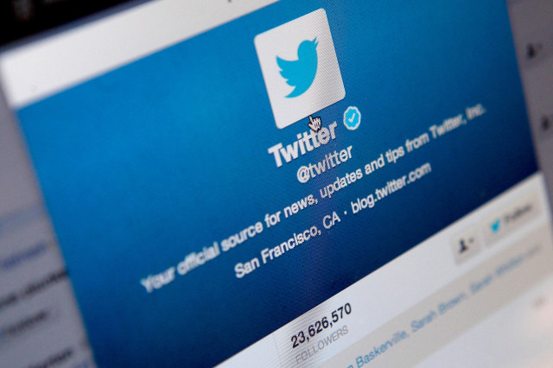
“There's research to show that quote-unquote text speak, is actually related to stronger reading and writing skills.”-Rey Junco
Notes:
Authority/Credibility:
Current/Continuity:
Content/Bias:
Citations/Links:
Navigation/Copyright:
Please elaborate this quote. Proof???
Music by XX

Slide 16
“Social media allows users to read, write, and share information quickly.”-Rey Junco
Notes:
Authority/Credibility:
Current/Continuity:
Content/Bias:
Citations/Links:
Navigation/Copyright:

Slide 17


Social Networking In School Education
Social networking serves several supportive functions for improving literacy in school education.
Provides students with new ways of fast and easy communication with their school faculty.
Notes:
Authority/Credibility:
Current/Continuity:
Content/Bias:
Citations/Links:
Navigation/Copyright:

Slide 18
Social Networking In School Education cont.
Provides students with a way of accessing their course content and other school information online.
Provides students with a way to find more information from different sources found on the Internet, beyond what information is taught in their classroom.
Notes:
Authority/Credibility:
Current/Continuity:
Content/Bias:
Citations/Links:
Navigation/Copyright:

Slide 19
The End
https://www.diigo.com/list/fullsaila4/David---Education
https://www.diigo.com/list/fullsaila4/Jamel--Education-1
https://www.diigo.com/list/fullsaila4/A4
https://www.diigo.com/list/fullsaila4/Khris
https://www.diigo.com/list/fullsaila4/list-2014071500184477
https://www.diigo.com/list/fullsaila4/Robert
Notes:
Authority/Credibility:
Current/Continuity:
Content/Bias:
Citations/Links:
Navigation/Copyright:

Slide 20
http://phandroid.com/2014/03/14/top-twitter-apps-android-2014/http://en.wikipedia.org/wiki/Illuminationism#mediaviewer/File:David_-_The_Death_of_Socrates_detail.jpg Image ID 310741000946 http://www.business2community.com/blogging/part-2-how-to-start-a-blog-and-not-be-overwhelmed-0348941#!bfLuvP http://commons.wikimedia.org/wiki/File:Logo_twitter_wordmark_1000.png http://rationalwiki.org/wiki/Reddit http://commons.wikimedia.org/wiki/File:Facebook_logo_(square).png http://en.wikipedia.org/wiki/University_of_Iowa#mediaviewer/File:Cleary_Walkway_with_the_Old_Capitol_in_the_background,_University_of_Iowa.JPG http://en.wikipedia.org/wiki/Wikipedia:Wikipedia_Signpost/2011-10-10/Opinion_essay
Citations
http://commons.wikimedia.org/wiki/File:Facebook_logo_(square).png
Notes:
Authority/Credibility:
Current/Continuity:
Content/Bias:
Citations/Links:
Navigation/Copyright:

